Slide 1
ARTIFICIAL NEURAL NETWORKS

Slide 2
ARTIFICIAL NEURAL NETWORK
A computer program designed to recognize patterns and learn “like” human brain

Slide 3
What is a neural network?
Biological organisms are capable of learning gradually over time.
The learning capability reflects the ability of biological neurons to learn through exposure to external stimuli and to generalize.
This learning capability of biological organisms from examples suggests possibilities for machine learning.
“Neural networks, or more specifically, artificial neural networks are mathematical models inspired from our understanding of biological nervous systems.”

Slide 4
Some Definitions of ANN
a neural network is a system composed of many simple processing elements operating in parallel whose function is determined by network structure, connection strengths, and the processing performed at computing elements or nodes.

Slide 5
According to Haykin, S. (1994),Neural Networks: A Comprehensive Foundation, NY: Macmillan, p. 2:
A neural network is a massively parallel distributed processor that has a natural propensity for storing experiential knowledge and making it available for use. It resembles the brain processor in two respects:
Knowledge is acquired by the network through a learning process.
Interneuron connection strengths known as synaptic weights are used to store the knowledge.

Slide 6
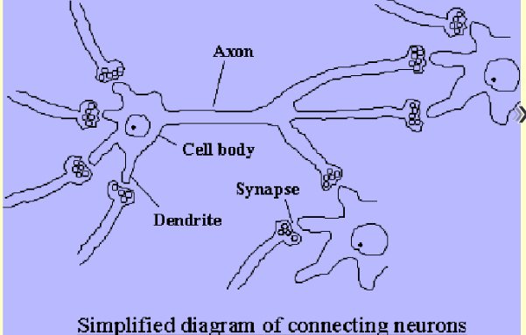
Every neuron is made up of SOMA or the CELL BODY where the decisions are made based on the information carried into the cell via DENDRITES.
The output from the soma is carried to other neurons or any other type of cells for excitation or inhibition, by the AXON.
The axon is coupled to other dendrites by the SYNAPSES.
Synaptic gap : Gap between axon terminals and dendrite of other cell ( 50-200 Angstrom)

Slide 7
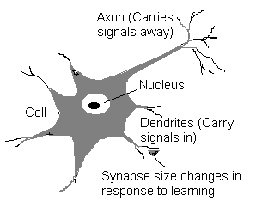
NEURON
Neuron = nerve cell
Soma = Cell Body
(decisions are made)
Dendrites – carry information into the cell
Axon – carry output to other neurons

Slide 8
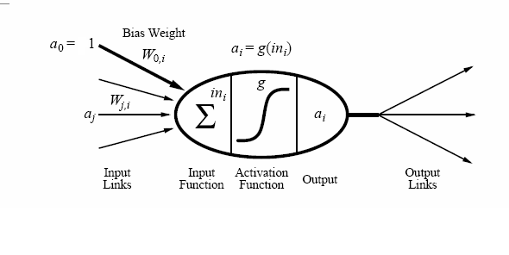
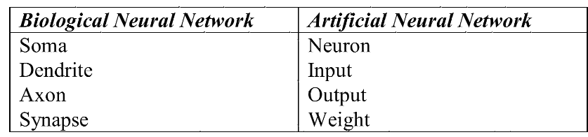
A neural network is a collection of artificial neurons.
An artificial neuron is a mathematical model of a biological neuron in its simplest form.

Slide 9
WHY USE ACTIVATION FUNCTIONS?
Activation functions are needed to introduce nonlinearity into the network.
Without non-linearity, hidden units would not make nets more powerful than just plain perceptrons (which do not have any hidden units, just input and output units).

Slide 10
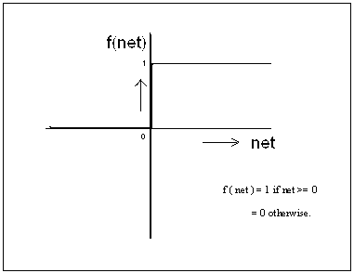

Slide 11
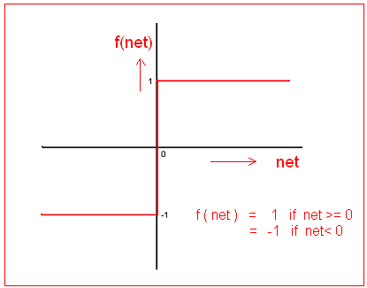

Slide 12
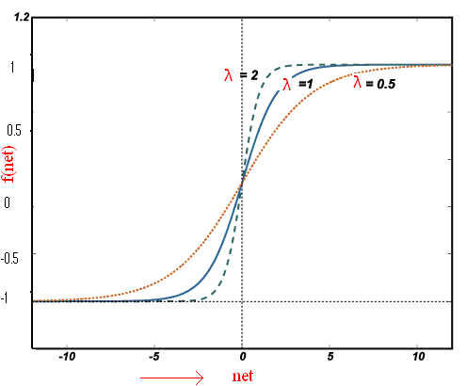
Tan Sigmoid activation function

Slide 13
Find f ’(net) wrt net in terms of y

Slide 15
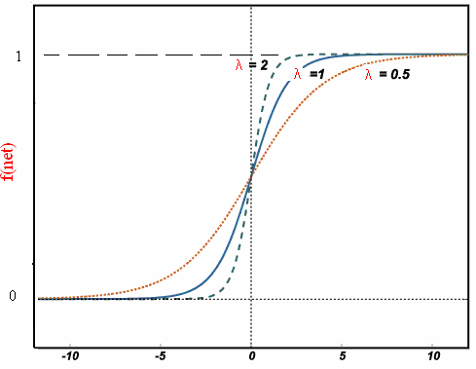
Log sigmoid activation function

Slide 16
Find f’(net) in terms of y

Slide 17
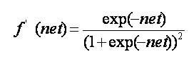

Slide 18
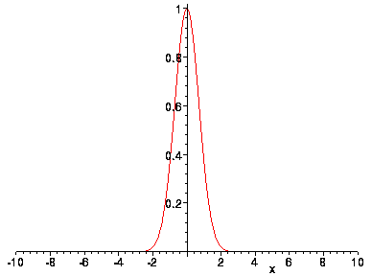
it is essentially zero everywhere except in a small region around zero.

Slide 19
McCulloch and Pitt’s Model
Proposed in 1943
consists of a summing element and a threshold function the artificial neuron produces a binary output
The neuron 'fires' when the weighted sum of inputs [w_{i}x_{i}] reaches or exceeds the threshold T
Could perform basic AND, OR, NOT

Slide 20
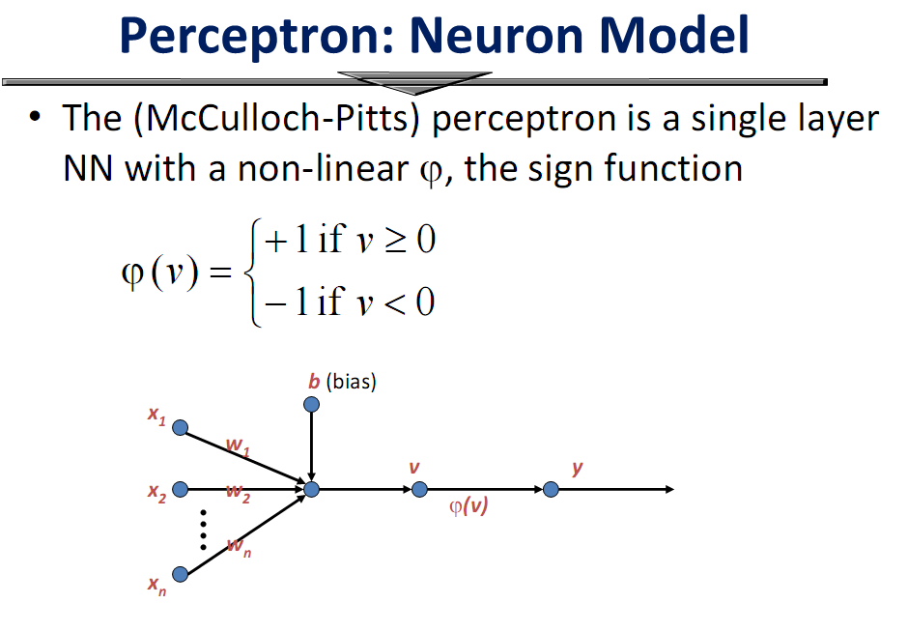
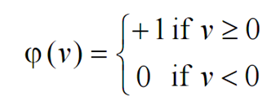

Slide 21
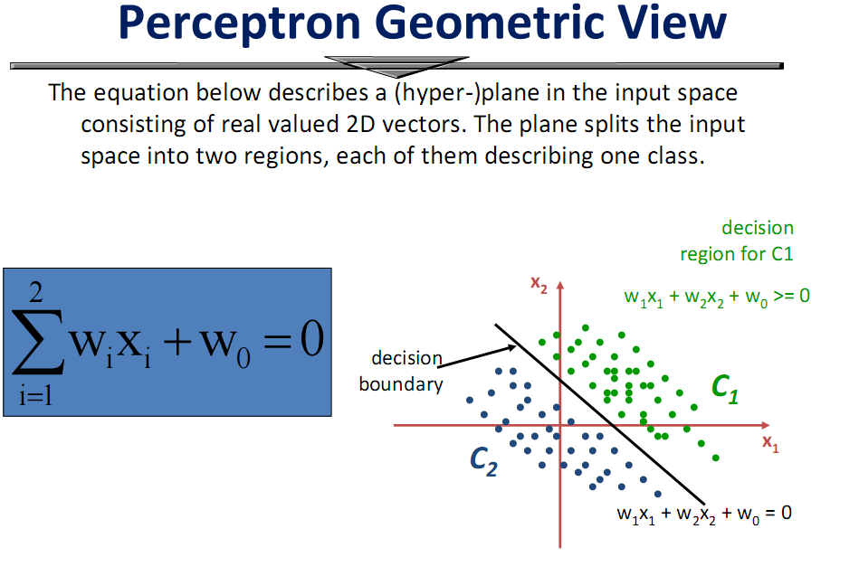

Slide 22
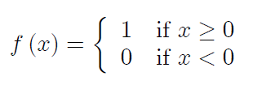
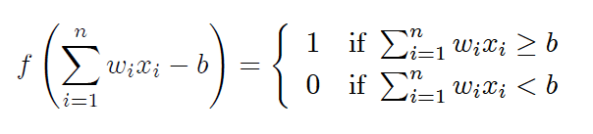
In the first computational model for artificial neurons, proposed by McCulloch and Pitts, outputs are binary, and the function f is the step function defined by:
Notice the quantify (-w₀) is a threshold that the weighted combination of inputs w₁x₁ + … + w_{n}x_{n} must surpass in order for perceptron to output a 1.

Slide 23
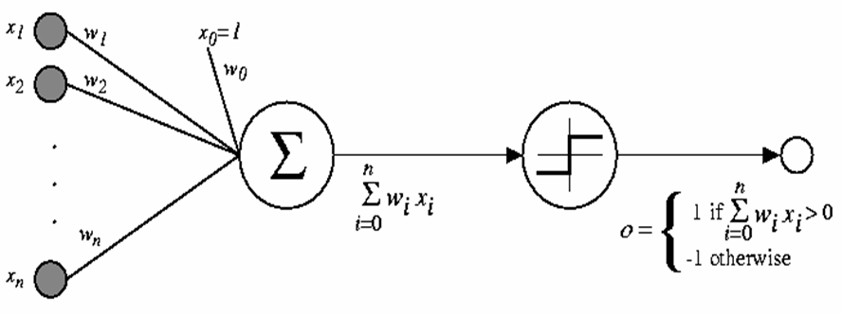
To simplify notation, we imagine an additional constant input x₀ = 1, allowing us to write the above inequality as
n
∑_{i=0} w_{i}x_{i} >0
Learning a perceptron involves choosing values for the weights w₀, w₁,…, w_{n}.

Slide 24
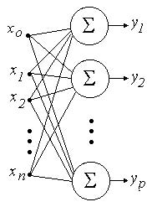
Single- layer neural network or perceptron:
Simple neural networks by considering several neurons at a time.
It consists of an input layer --a layer of input nodes and --one output layer consisting of neurons.
This is referred to as a single- layer neural network because the input layer is not a layer of neurons, that is, no computations occur at the input nodes.
Perceptron model can only solve linearly separable problems
Single- layer neural network

Slide 25
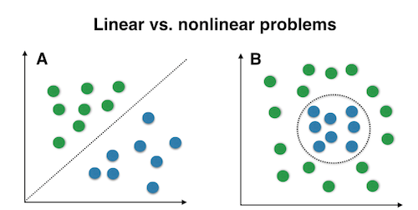
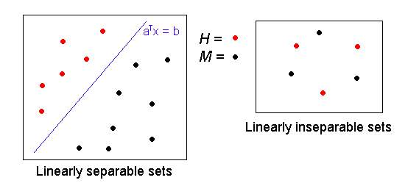

Slide 26
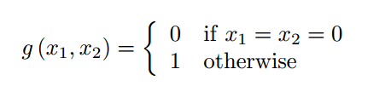
Example 1:
Design a perceptron to implement the logical Boolean function OR, that is, the function g: {0,1} × {0,1} → {0,1}, defined by
In view of the function g, we consider binary-input/binary-output neural networks, with two nodes in the input layer, and only one neuron in the output layer.

Slide 27
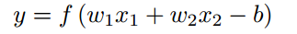
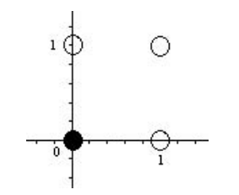
The problem is to choose w₁, w₂, and b so that
First, to see whether or not this problem is solvable, we look at the domain of the function g,
coloring the points white where the function value is 1,
and black where the function value is 0.

Slide 28
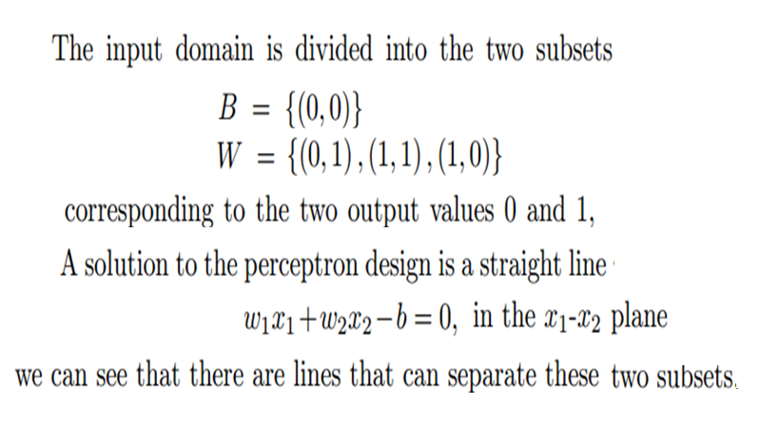
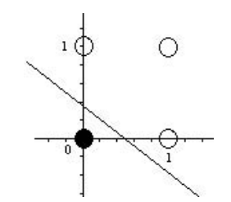

Slide 29
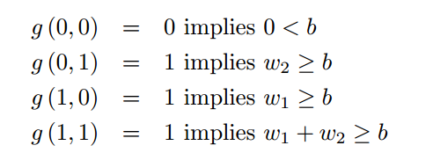
Of course, there are many such lines, and any such line gives a solution. In view of the simplicity of this function g, no sophisticated mathematics is needed. Just observe that:
and choose any numbers for w₁ ,w₂ , and b satisfying these inequalities.
One solution is w₁ = w₂ = b = 2.

Slide 30
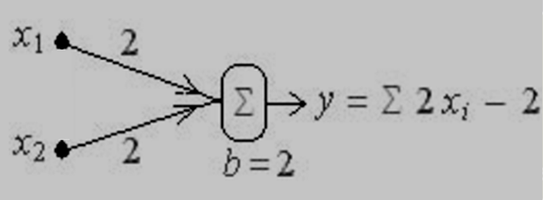
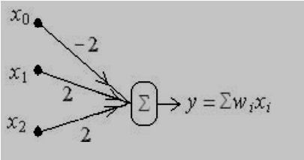
equal to:

Slide 31
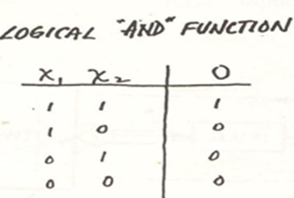
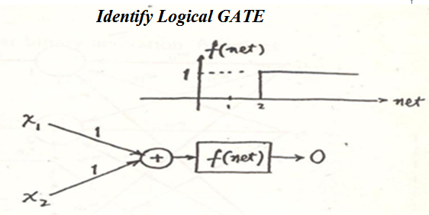
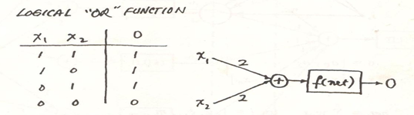

Slide 32
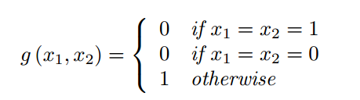
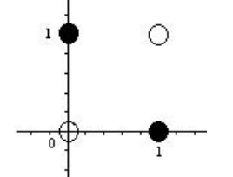
Example
The exclusive or(XOR) is the Boolean function with truth table:
When we display the input-output relationship expressed by g, we see that this problem is not linearly separable

Slide 33
That is, there is no line that can separate the two subsets
White={(0,0),(1,1)} and Black={(0,1),(1,0)}.
Therefore, the function g cannot be implemented by using a perceptron, so we need to consider a hidden layer.

Slide 34
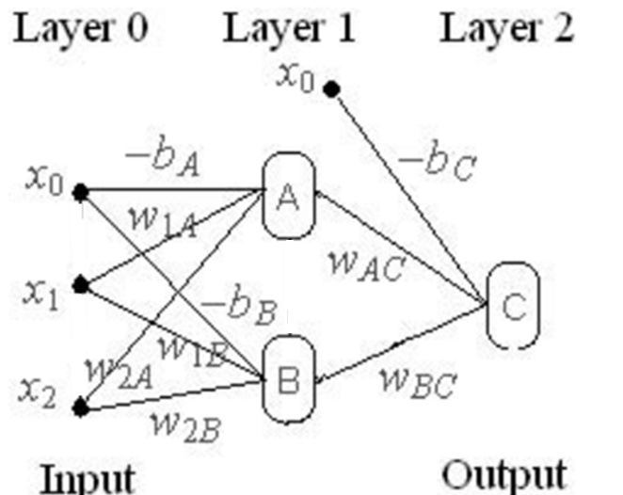

Slide 35
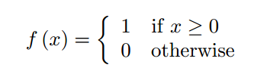
This is a multi-layer neural network in which
the input layer (or layer0)has two nodes x₁, x₂(no computation), together with x₀=1 to implement the bias for neurons A and B;
the hidden layer has two hidden neurons A and B, with x₀ =1 to implement the bias for neuron C;
and the output layer consists of only one neuron C.
For all neurons, the “activation function” f is taken to be

Slide 36
Consider, for example, x₁ = x₂ =1. We expect the network to produce the Output y= 0. The output y is computed in several steps. The net input to Neuron A is w_{1A}x₁+w_{2A}x₂−b_{A.}
So that the output neuron A is y₁=f(w_{1A}x₁+w_{2A}x₂−b_{A})
Similarly, the output of neuron B is y₂=f(w_{1B}x₁+w_{2B}x₂−b_{B}).

Slide 37
Hence, the net input to neuron C, from neurons A and B with the condition it must satisfy, is
to result in the output y=0 when x₁ = x₂ = 1.

Slide 38
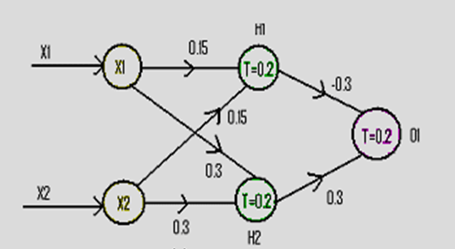
Make a table
I/P I/P HL O/P HL I/P O1 O/P o1
X₁ X₂ H₁ H₂ H₁ H₂

Slide 39
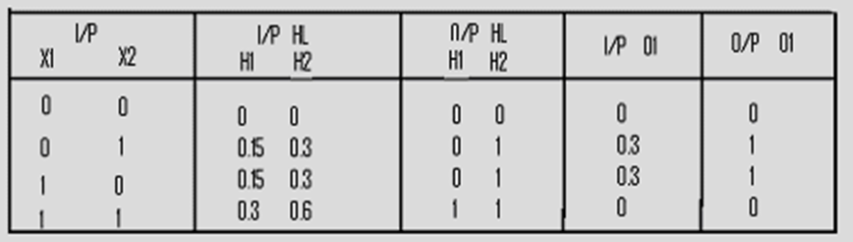
More layers seem to increase the computation power of neural networks.

Slide 40
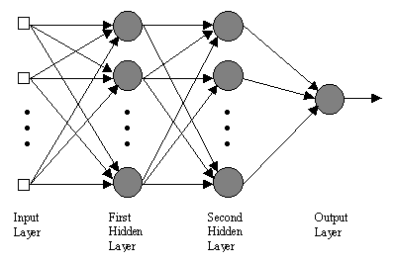
THE MULTILAYER PERCEPTRON

Slide 41
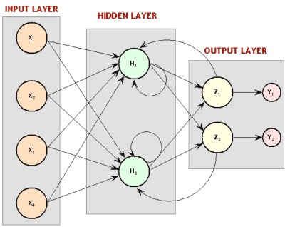
RECURRENT NETWORKS

Slide 42
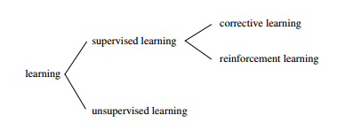

Slide 43
Supervised learning contd.
Supervised learning does minimization of error

Slide 44
Unsupervised learning
Training samples contain only input patterns
No desired output is given (teacher-less)
Learn to form classes/clusters of sample patterns according to similarities among them
Patterns in a cluster would have similar features
No prior knowledge as what features are important for classification, and how many classes are there.

Slide 45
Unsupervised Learning
All similar input patterns are grouped together as clusters.
If a matching input pattern is not found a new cluster is formed

Slide 46
Unsupervised learning

Slide 47
Unsupervised(Self-organizing)
In unsupervised learning there is no feedback
Network must discover patterns, regularities, features for the input data over the output
While doing so the network might change in parameters
This process is called self-organizing

Slide 48
When Reinforcement learning is used?
Reinforcement : learning motor skills like riding a bike
You try and see what makes you fall over and what keeps you upright
If less information is available about the target output values (critic information)
Learning based on this critic information is called reinforcement learning and the feedback sent is called reinforcement signal

Slide 49
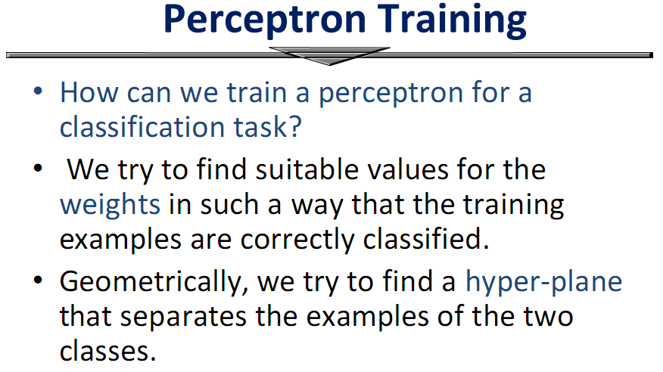

Slide 50
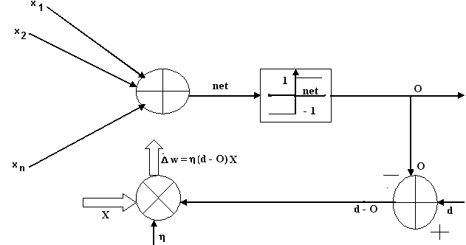
Perceptron learning rule

Slide 51
One way to learn an acceptable weight vector is to begin with random weights, then iteratively apply the perceptron to each training example, modifying the perceptron weights whenever it misclassifies an example.
This process is repeated, iterating through the training examples as many as times needed until the perceptron classifies all training examples correctly.
Weights are modified at each step according to the perceptron training rule, which revises the weight w_{i} associated with input x_{i} according to the rule.
w_{i} ← w_{i} + Δw_{i}
where Δw_{i} = η(t – o) x_{i}
t is target output value for the current training example
o is perceptron output
η is small constant (e.g., 0.1) called learning rate

Slide 52
Perceptron training rule (cont.)
The role of the learning rate is to moderate the degree to which weights are changed at each step. It is usually set to some small value (e.g. 0.1) and is sometimes made to decrease as the number of weight-tuning iterations increases.
We can prove that the algorithm will converge
If training data is linearly separable
and η sufficiently small.
If the data is not linearly separable, convergence is not assured.

Slide 53
Perceptron Learning Algorithm
Weights are set randomly initially
For each training example E
Calculate the observed output from the ANN, o(E)
If the target output t(E) is different to o(E)
Then tweak all the weights so that o(E) gets closer to t(E)
Tweaking is done by perceptron training rule (next slide)
This routine is done for every example E
Don’t necessarily stop when all examples used
Repeat the cycle again (an ‘epoch’)
Until the ANN produces the correct output
For all the examples in the training set (or good enough)

Slide 54
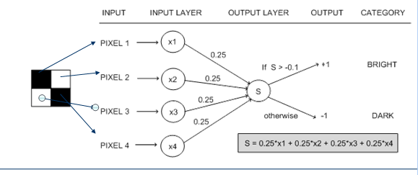
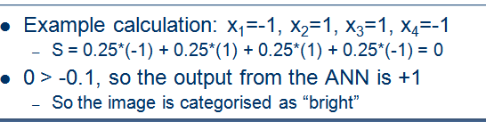

Slide 55
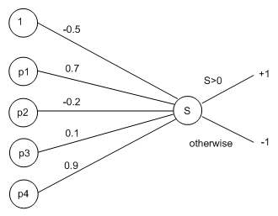
Worked Example
Return to the “bright” and “dark” example
Use a learning rate of η = 0.1
Suppose we have set random weights:

Slide 56
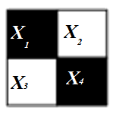
Use this training example, E, to update weights:
Here, x1 = -1, x2 = 1, x3 = 1, x4 = -1 as before
Propagate this information through the network:
S = (-0.5x 1) + (0.7x (-1)) + (-0.2 x 1) + (0.1x1) + (0.9x(-1)) = -2.2
Hence the network outputs o(E) = -1
But this should have been “bright”=+1
So t(E) = +1

Slide 57
Calculating the Error Values
Δw₀ = η(t(E)-o(E))x₀
= 0.1 x [(1 - (-1)] x1 = 0.1x (2) = 0.2
Δw₁ = η(t(E)-o(E))x₁
= 0.1x[ (1 - (-1)] x(-1) = 0.1x (-2) = -0.2
Δw₂ = η(t(E)-o(E))x₂
= 0.1x[ (1 - (-1)] x (1) = 0.1 x (2) = 0.2
Δw₃ = η(t(E)-o(E))x₃
= 0.1 x (1 - (-1))x (1) = 0.1 x (2) = 0.2
Δw₄ = η(t(E)-o(E))x₄
= 0.1 x [(1 - (-1)]x (-1) = 0.1x (-2) = -0.2

Slide 58
Calculating the New Weights
w’₀ = -0.5 + Δw₀ = -0.5 + 0.2 = -0.3
w’₁ = 0.7 + Δw₁ = 0.7 + -0.2 = 0.5
w’₂ = -0.2 + Δw₂ = -0.2 + 0.2 = 0
w’₃= 0.1 + Δw₃ = 0.1 + 0.2 = 0.3
w’₄ = 0.9 + Δw₄ = 0.9 - 0.2 = 0.7

Slide 59
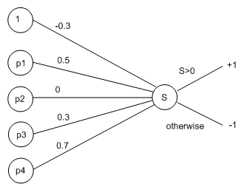
Calculate for the example, E, again:
S = (-0.3 x 1) + ((0.5x(-1)) + (0x1) + (0.3 x1) + ((0.7x(-1)) = -1.2
Still gets the wrong categorisation
But the value is closer to zero (from -2.2 to -1.2)
In a few epochs time, this example will be correctly categorised

Slide 60
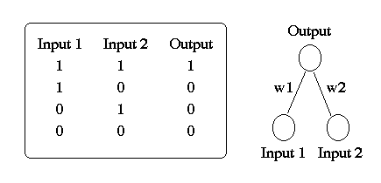
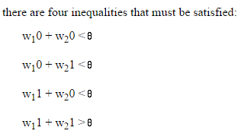
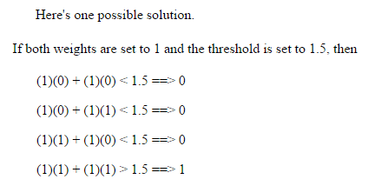

Slide 61
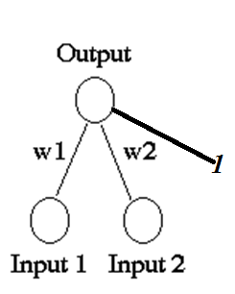
x₁ | x₂ | y
1 | 1 | 1
1 | 0 | -1
0 | 1 | -1
0 | 0 | -1
A perceptron for the AND function is defined
as follows :
Binary inputs ( 0/1),
Bipolar targets ( ±1)
Initial weights and bias equal to 0,
threshold = 0.2=θ

Slide 62

Perceptron learning rule

Slide 63



Presenting the first input yields the following

Slide 64



Presenting the second input yields the following
Response of net will now be correct for first pattern (1,1,1), as net will be 0x1+1x1+1x0=1 so f(net)=1=target
Every epoch will have four inputs

Slide 65


Presenting the third input yields the following
Response of net will be negative (correct), correct for 3 inputs
Presenting the fourth input yields the following
The response for all of the input patterns is negative for the weights derived; but since the response for the input pattern (1,1) is not correct, we need to perform one more EPOCH

Slide 66



SECOND EPOCH, FIRST TRAINING INPUT
The response of the net will now be correct for (1,1)

Slide 67



SECOND EPOCH, SECOND TRAINING INPUT
Response of net will now be correct ( negative) for (1,0) and (0,0) and response for (0,1) and (1,1) will be 0, not correct should 1

Slide 68


SECOND EPOCH, THIRD TRAINING INPUT
RESPONSE WILL BE ENGATIVE FOR ALL INPUTS
SECOND EPOCH, FOURTH TRAINING INPUT
RESPONSE WILL BE ENGATIVE FOR ALL INPUTS

Slide 69

Finally, the results for the tenth epoch are:
INPUTS NET OUTPUT TARGET WEIGHT WEIGHTS
CHANGES
(1 1 1) | 1 | 1 | 1 | (0 0 0) | (2 3 -4)
(1 0 1) | -2 | -1 | -1 | (0 0 0) | (2 3 -4)
(0 1 1) | -1 | -1 | -1 | (0 0 0) | (2 3 -4)
(0 1 1) | -4 | -1 | -1 | (0 0 0) | (2 3 -4)

Slide 70


Slide 71







Slide 72


Slide 73
Although the perceptron rule finds a successful weight vector when the training examples are linearly separable, it can fail to converge if the examples are not linearly separatable.
A second training rule, called the delta rule, is designed to overcome this difficulty.

Slide 74
The key idea of delta rule:
to use gradient descent to search the space of possible weight vector to find the weights that best fit the training examples.
This rule is important because it provides the basis for the backpropagration algorithm, which can teach networks with many interconnected units.

Slide 75
Gradient descent is a first-order optimization algorithm. To find a local minimum of a function using gradient descent, one takes steps proportional to the negative of the gradient(or of the approximate gradient) of the function at the current point.
If instead one takes steps proportional to the positive of the gradient, one approaches a local maximum of that function; the procedure is then known as gradient ascent.
Gradient descent is also known as steepest descent, or the method of steepest descent.

Slide 76



Slide 77


Slide 78

In order to derive a weight learning rule for linear units, let specify a measure for the training error of a weight vector, relative to the training examples. The Training Error can be computed as the following squared error
(2)
where D is set of training examples, t_{d} is the target output for the training example d and o_{d} is the output of the linear unit for the training example d.
Here we characterize E as a function of weight vector because the linear unit output O depends on this weight vector.

Slide 79
Hypothesis Space
To understand the gradient descent algorithm, it is helpful to visualize the entire space of possible weight vectors and their associated E values, as illustrated in Figure
Here the axes w_{o},w₁ represents possible values for the two weights of a simple linear unit. The w_{o},w₁ plane represents the entire hypothesis space.
The vertical axis indicates the error E relative to some fixed set of training examples. The error surface shown in the figure summarizes the desirability of every weight vector in the hypothesis space.
For linear units, this error surface must be parabolic with a single global minimum. And we desire a weight vector with this minimum.

Slide 80

The error surface
How can we calculate the direction of steepest descent along the error surface? This direction can be found by computing the derivative of E w.r.t. each component of the vector w.

Slide 81

w_{i} (new) = w_{i} (old) - η ∇E
If Error gradient is negative:
w_{i} (new) = w_{i} (old) + η ∇E
w_{i} (new) > w_{i}(old)
If Error gradient is positive:
w_{i} (new) = w_{i} (old) - η ∇E w_{i} (new) < w_{i}(old)

Slide 82



Slide 83
Learning rate
Determines how far to move in the direction of the gradient of the surface over the weight space defined by an error function.
A small learning rate will lead to slower learning, but a large one may cause a move through weight space that ``overshoots'' the solution vector.
learning rate Too small
■ Convergence extremely slow
learning rate Too large
■ May not converge

Slide 84

DELTA LEARNING RULE valid for continuous activation functions
∆w = (η (d₁ – o₁)(f ’ (net_{i} )) x
Node i

Slide 85
BACK-PROPAGATION LEARNING ALGORITHM
The training involves three stages:
1)Feed forward of the input training pattern
2)Calculation and backpropogation of the associated error
3)Adjustment of weights

Slide 86
Three Major Phases Using Backpropagation
First phase: an input vector is presented to the network which leads via the forward pass to the activation of the network as a whole. This generates a difference (error) between the output of the network and the desired output.
Second phase: compute the error vector for the output unit and propagates this factor successively back through the network (error backward pass).
Third phase: compute the changes for the connection weights .

Slide 87




Slide 88
INSTANTEOUS BACK PROPAGATION ALGORITHM
See Reference Book : process Control by Surekha Bhanot

Slide 89
DIFFERENT MODES OF TRAINING
For a given training set, back propagation learning
may thus proceed in one of two basic ways:
1) Pattern or Sequential mode
2) Batch mode

Slide 90
Pattern mode/Sample-by-sample/Online : ANN wieghts are updated every time a training sample is presented to the network, i.e. weight update is based on training error from that sample.
Batch-mode (offline) : ANN weights are updated after each Epoch, i.e. weight update is based on training error from all samples in training data set
An Epoch is defined as a cycle of ANN training that involves presentation of all samples in the training data set to neural network for purpose of learning

Slide 91
PATTERN MODE OF TRAINING
In the case of pattern mode, the whole sequence of
forward and backward computation is performed
resulting in weight adjustment for each pattern
X (1)/ D (1) to X (N)/D (N)
Pattern mode of training is online, requires less local
storage

Slide 92
PATTERN MODE OF TRAINING
The steps involved in pattern mode can be summarized
as follows:
1) Initialize the weights , p =1 and E = 0
2) Submit the pattern p
3) Compute output of all nodes in all layers(forward pass)
4) Compute cycle error
E→
for k = 1,2 ….n

Slide 93
PATTERN MODE OF TRAINING
5) Compute new weights (backward pass)
6) If p < N, p→ p + 1 repeat steps (2) to (5)
for all patterns
7) Compute RMS error
where N is the number of patterns
8) If RMS error > E_{max} repeat steps (2) through (7)
submit patterns again after resetting E→ 0

Slide 94
BATCH MODE OF TRAINING
In batch mode the weight up gradation is done after
the whole N sets are presented
One completed presentation of entire training set
is called an Epoch.
Batch mode is more accurate

Slide 95
BATCH MODE OF TRAINING
The steps involved in batch mode can be summarized
as follows:
1) Initialize the weights
2) Submit the pattern p=1
3) Calculate and store error at all output nodes.
4) If p< N, then p → p + 1 and go to step (2)

Slide 96
6) Calculate average error at all output nodes(1 to k)
7) If (Error)_{average} is less than E_{max} Stop
else
Calculate new weights (backward pass) and go to step 2

Slide 97
Data Representation
In general ANNs work on continuous (real valued) attributes. Therefore symbolic attributes are encoded into continuous ones.
Attributes of different types may have different ranges of values which affect the training process.
Normalization may be used, which scales each attribute to assume values between 0 and 1.
for each value x_{i} of i^{th} attribute, min_{i} and max_{i} are the minimum and maximum value of that attribute over the training set.

Slide 98
MULTILAYER NETWORKS AND THE BACKPROPOGATION ALGORITHM
Single perceptrons can only express linear decision surfaces. In contrast, the kind of multilayer networks learned by the backpropagation algorithm are capable of expressing a rich variety of nonlinear decision surfaces.
A Differentiable Threshold Unit
What type of unit as the basis for multilayer networks ?
• Perceptron : not differentiable -> can’t use gradient descent
• Sigmoid Unit : smoothed, differentiable threshold function

Slide 99
REMARKS ON THE BACKPROPAGATION ALGORITHM
Convergence and Local Minima
Gradient descent to some local minimum
Perhaps not global minimum...
Heuristics to alleviate the problem of local minima
Add momentum
Train multiple nets with different initial weights using the same data.

Slide 100
Adding Momentum
Imagine rolling a ball down a hill
Without Momentum With Momentum
Gets stuck
here

Slide 101
Momentum in Backpropagation
For each weight
Remember what was added in the previous epoch
In the current epoch
Add on a small amount of the previous Δ
The amount is determined by
The momentum parameter, denoted α
α is taken to be between 0 and 1

Slide 102
Adding Momentum
Here Δw_{i,j}(n) is the weight update performed during the n-th iteration through the main loop of the algorithm.
- n-th iteration update depend on (n-1)th iteration
- α: constant between 0 and 1 is called the momentum ( typical value 0.6 to 0.9).
Role of momentum term:
- keep the ball rolling through small local minima in the error surface.
- Gradually increase the step size of the search in regions where the gradient is unchanging, thereby speeding convergence.

Slide 103



Idntify Unde-rfit, Over-fit, Good- fit
Underfitting
Over-fitting
Good-fitting

Slide 104




Slide 105


For banana (d₆) = 1, (d₇ ) = 0
For Orange (d₆) = 0, (d₇ ) = 1

Slide 106


Slide 107


Slide 108


Slide 109



Slide 110


Slide 111


Slide 112


Slide 113
A neural network for temperature control
SEE TEXT BOOK p205-209
We first demonstrate a very simple neural network for control application where the neural network is intended to function as an ON/OFF controller
The objective is to train the NN so that when the measured temperature is higher than desired the neural controller shuts OFF the furnace and when the measured temperature is below the desired temperature then the neural controller turns ON the surface
To train the NN to recognize the error between the desired and measured temperature and provide ON/OFF control

Slide 114
Two numbers X and Y are to be compared on the cross space [-2,2] x[-2,2]. Output of network is a 3 bit pattern corresponding to ( top node : X >Y, middle node : X<Y, bottom node :X=Y) taking value 0 if false and value 1 for true.
Use BPA algorithm for input pair ( X,Y)= ( -2, -1) for one epoch with neural architecture in which there is a single neuron in single hidden layer. Learning coefficient is 0.1, initial weights and biases at all hidden and output nodes are 0.5, activation function for all layers is logsigmoid. (i) Draw the ANN network with weights, biases and inputs/outputs (ii) Find Error vectors at output and hidden nodes and (iii) Find new weights and biases.
Write Matlab Code for the same problem to train and test neural network of three hidden layers with 2, 3, 4 nodes respectively in these hidden layers. Generate patterns with X and Y changing in increments of 1 , divide the patterns into training data and test data picking alternate one in each set. Biases at all hidden nodes are 0.1, learning coefficient is 0.9, activation function at output layer is linear and at all other layers is bipolar sigmoid, training goal is 10⁻⁸. All other parameters are default values (do not write commands for them).

Slide 116
Net=newff(minmax(p), [ 2 3 4 3]{‘tansig’ , ‘tansig’, ‘tansig’, ‘purelin’},trainrp)
Net.train.Param.lr=0.9
Net.train.param.goal=1e-8
Net.b{1}=[0.1;0.1];
Net.b{2}=[0.1;0.1;0.1]
Net.b{3}=[0.1;0.1;0.1;0.1];
Net=train(net,p,t)
A=sim(net,p’)

